Slide 1
HBY Auto
E-marketing strategy
YUSUF SASMAZ – 231ADM069
HASAN CAN – 221ADM113
BURAK CAKA - 221ADM112
VEPA TULIYEV- 231ADM200

Slide 2



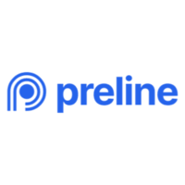
Website Development
Technology Stack:
Frontend: HTML5, CSS3, JavaScript (ES6+), React.js. Tailwind. Preline UI
Backend: PHP 8.2, Laravel 11
Database: MySQL 8.0
Hosting: Amazon Web Services (AWS) EC2 instance with CloudFront CDN for optimal performance and scalability.
User Interface (UI) and User Experience (UX) Design:

Slide 3
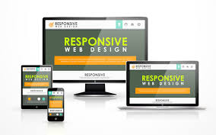

Website Development
Mobile-First Design:
Responsive Design: Smartphones, Tablets, Desktops
Cross-Browser Compatibility: (Chrome, Firefox, Safari, Edge)
Performance Optimization:
Image Optimization: using WebP format to minimize file sizes without sacrificing visual quality, resulting in faster page load speeds.
Caching Mechanisms: Implementation of browser caching and server-side caching will significantly reduce page load times, improving user experience and SEO.
Code Optimization: Minification of HTML, CSS, and JavaScript files will be performed to streamline code and further enhance rendering speed.

Slide 4
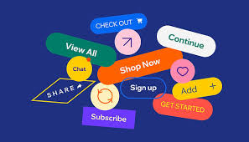
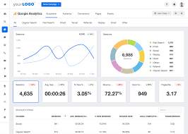

Website Development
Strategic Call-to-Actions (CTAs):
Placement & Prominence: ("Shop Now," "Learn More," "Get a Free Quote").
Visual Hierarchy: CTAs will be visually emphasized using contrasting colors, compelling microcopy, and button design best practices to stand out from surrounding content.
Analytics Integration:
Google Analytics 4: Tracking of website traffic, user behavior, conversion rates, and other critical metrics for data-driven decision-making.
Event Tracking: Specific user interactions (button clicks, form submissions, video plays) will be tracked to gain granular insights into user engagement and website performance.
Security and Trust:
HTTPS Implementation: Encrypt communication between the website and users' browsers, protecting sensitive information.
Trust Badges: Display of prominent trust badges from reputable organizations like Norton Secured or McAfee Secure to instill confidence in website visitors and reinforce trust.
Secure Checkout Process (E-commerce): For e-commerce functionality, we'll implement a robust and PCI-compliant checkout process with industry-standard encryption to safeguard customer data.

Slide 5
Search Engine Optimization (SEO)
Notes:
We're diving into the crucial area of Search Engine Optimization, or SEO. Think of SEO as the rocket fuel that propels your website to the top of search engine results pages, driving organic traffic and attracting your ideal customers.

Slide 6
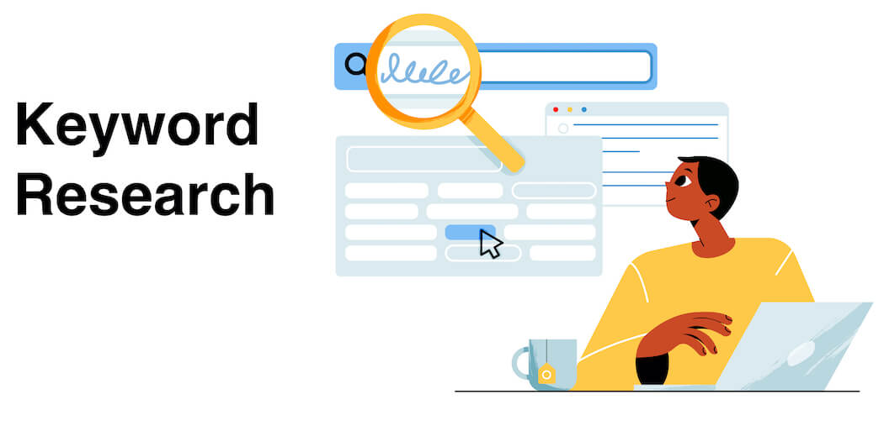
In-Depth Keyword Research
Identify high-volume, low-competition keywords
Utilize tools like Ahrefs and SEMrush
Focus on relevant terms your target audience uses
Target long-tail keywords for specific intent
Notes:
Our first step is thorough keyword research. We'll use powerful tools like Ahrefs and SEMrush to identify keywords with high search volume and manageable competition. This ensures we're targeting the right audience with the right terms.

Slide 7
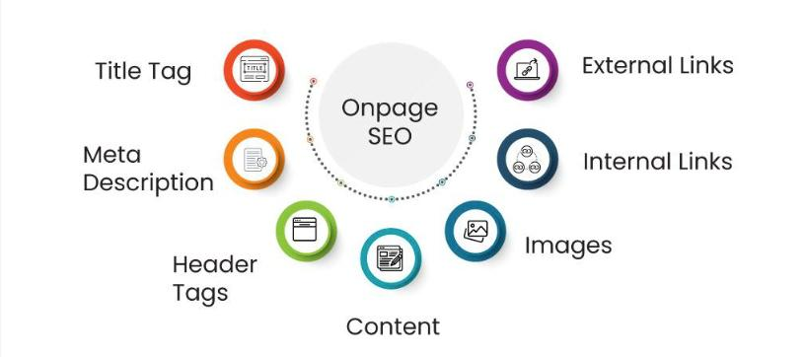
On-Page Optimization
Optimize title tags and meta descriptions
Structure content with header tags (H1-H6)
Integrate keywords naturally throughout content
Optimize image alt text for search visibility
Notes:
Next, we'll optimize your website's content for search engines. This includes crafting compelling title tags and meta descriptions, structuring your content with header tags, and naturally integrating relevant keywords throughout your pages.

Slide 8
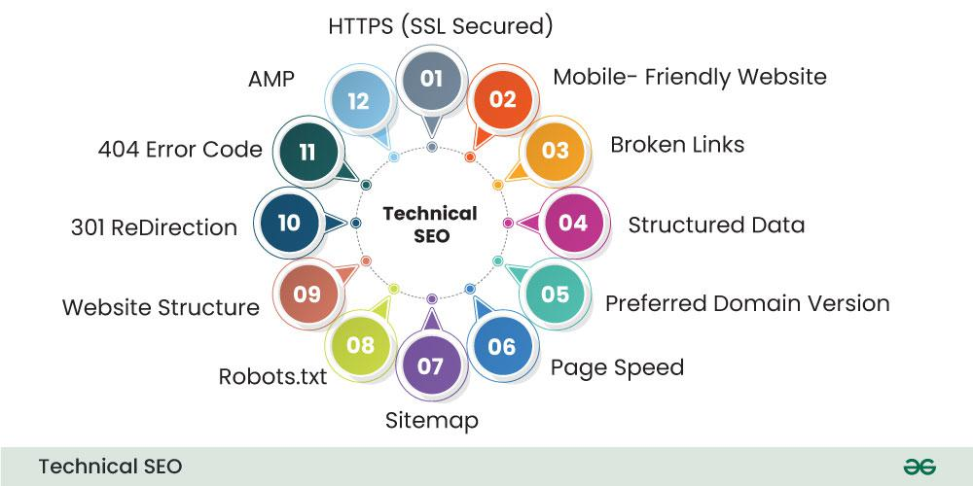
Technical SEO
Implement a clean URL structure
Submit an XML sitemap to search engines
Optimize robots.txt for efficient crawling
Ensure mobile-first indexing compatibility
Notes:
Technical SEO is about ensuring your website is built for optimal search engine crawling and indexing. We'll focus on clean URL structure, XML sitemap submission, robots.txt optimization, and mobile-first indexing.

Slide 9
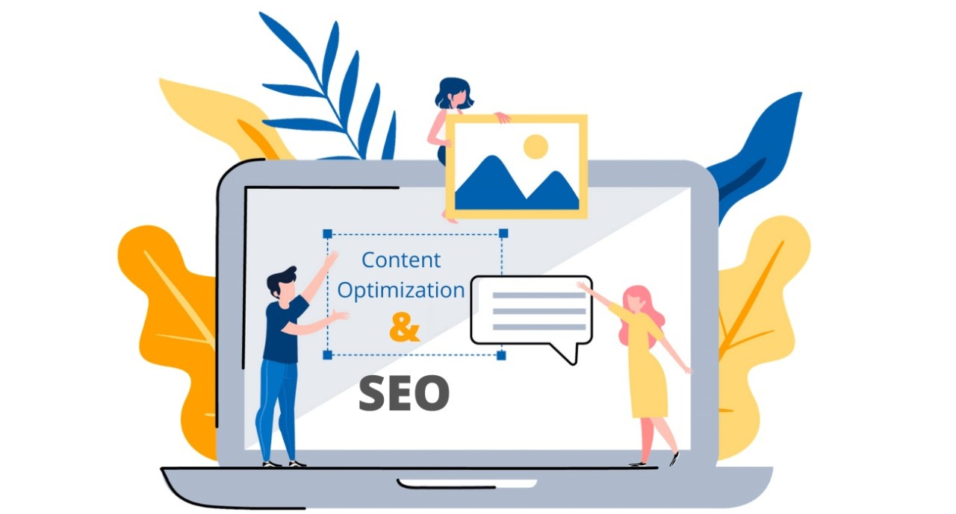
Content Optimization
Publish original, high-quality, and valuable content
Maintain an active blog with informative articles
Incorporate keywords naturally for search visibility
Create engaging content that resonates with your audience
Notes:
Our content strategy is about creating high-quality, original, and valuable content that attracts and engages your target audience. We'll maintain an active blog, incorporate relevant keywords naturally, and ensure our content is informative and engaging.

Slide 10
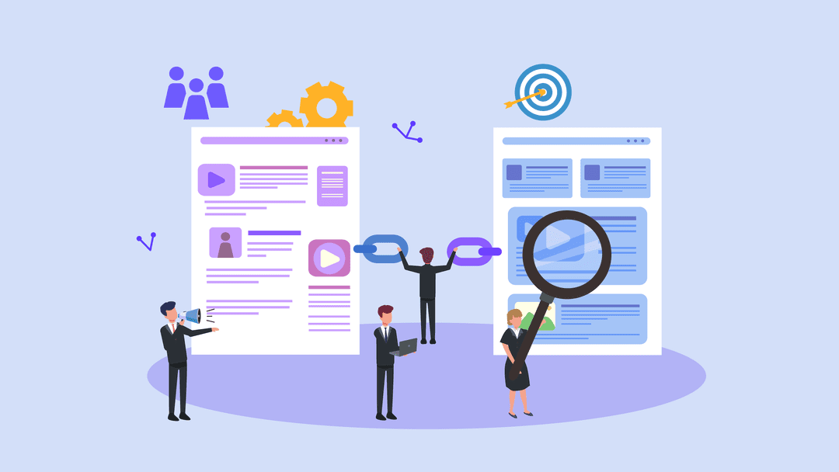
Link Building
Acquire high-quality backlinks from reputable sources
Utilize guest blogging, broken link building, and resource page link building
Build relationships with industry influencers and publications

Slide 11
Paid Advertisements
Notes:
I will talk about how paid advertising can be a powerful tool for our new automotive brand. This advertising model includes different formats such as PPC (Pay-Per-Click), display ads and social media ads. We chose PPC as our primary strategy.

Slide 12
PPC Advertising
PPC (Pay Per Click) advertising is a digital marketing strategy placing ads on search engines and other online platforms.
We only pay when a user clicks on our ad, making this a cost-effective approach.
66% of the automotive calls generated by search engines come from paid search.
Notes:
(son maddeden sonra)That is why automotive PPC advertising is a powerful tool our brand.

Slide 13
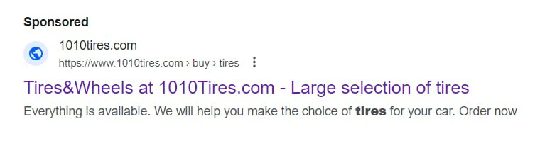
Paid ads on search
Google generated over 61% of all searches in January 2022
Notes:
(maddeden sonra)So paid search strategy on Google Ads is our priority.

Slide 14
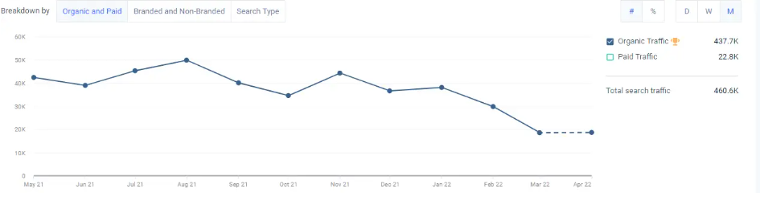
Tracking and Analytics
SimilarWeb
Notes:
We also use SimilarWeb to track traffic

Slide 15
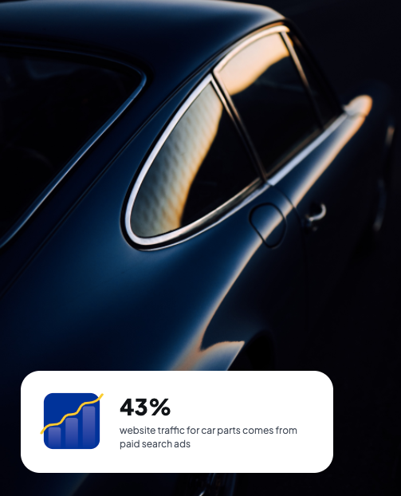
Benefits of PPC Advertising
Increased Visibility
Targeted Reach
Cost Control
Competitive Advantage
Notes:
PPC advertising allows our brand to reach a wide audience by placing ads at the top of search engine results.
PPC allows brand to display their ads to specific groups of people based on their age, location, and interests; which makes them more likely to buy something
This model allows us to pay only when someone clicks on our ad and allows us to manage the budget
PPC ads appear above organic search results and help the brand stand out from competitors and attract more clicks

Slide 16
Social Media Marketing
Notes:
I will talk about how paid advertising can be a powerful tool for our new automotive brand. This advertising model includes different formats such as PPC (Pay-Per-Click), display ads and social media ads. We chose PPC as our primary strategy.

Slide 17

Social Media Marketing
The right social media platforms for our target audience:
Facebook
Instagram
LinkedIn

Slide 18

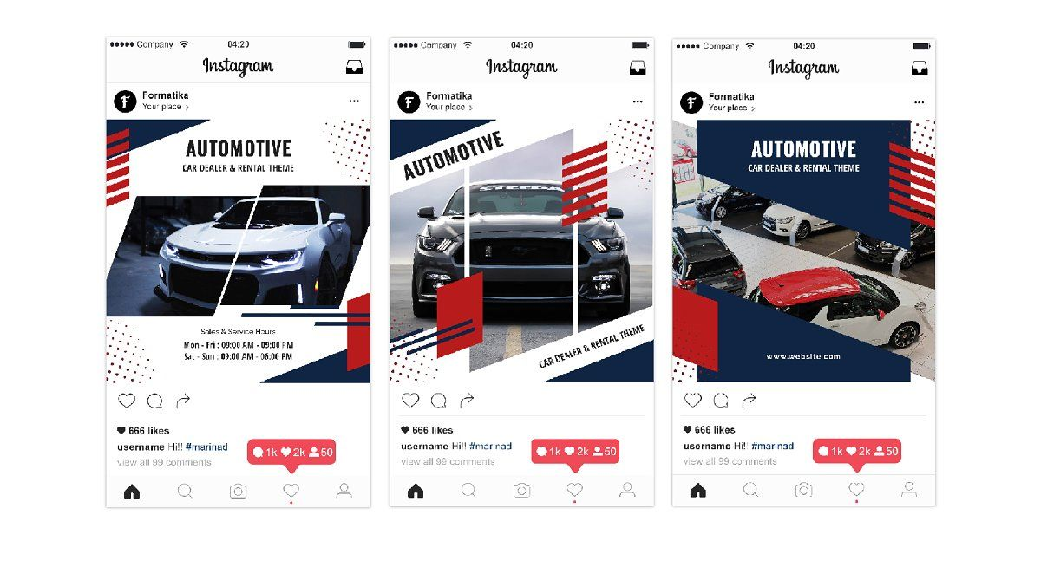
Social Media Marketing
Content calendar:
A variety of content
Posts weeks
Sometimes even months
Sneak peeks of upcoming models

Slide 19
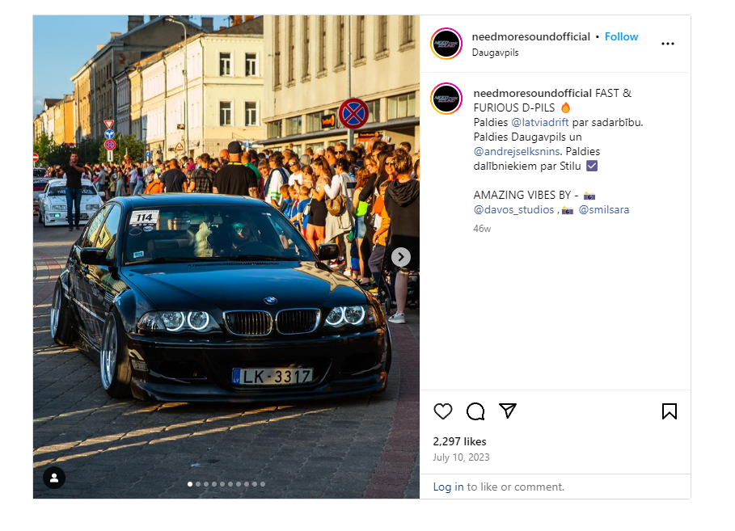
Social Media Marketing
Respond to comments and messages
The occasional contest
Giveaway
Make followers part of our community

Slide 20

Social Media Marketing
Collaboration:
Partnering with influencers
Enthusiasts
Reviewers
Lifestyle bloggers

Slide 21
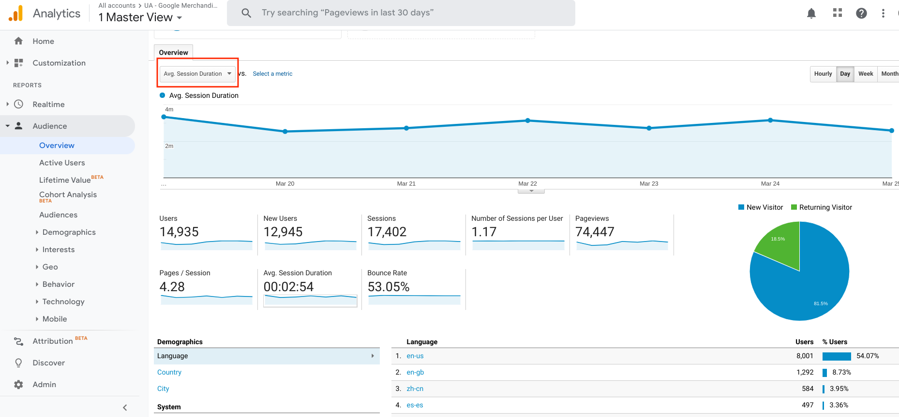
Social Media Marketing
Analytics:
Engagement rates
Reach
Conversions

Slide 22
Content Marketing

Slide 23
Content Marketing
92% of car buyers research online before they buy.
A single consumer engages in more than 900 digital interactions in the entire car buying journey, from awareness to purchase
More than half (56%) of car shoppers said they would be convinced to buy a car if they could watch a 360-degree video without having to test drive the vehicle.

Slide 24
Content Marketing Strategies
Visual storytelling
Unlike traditional content marketing, where products are not the focus, it achieves success by giving leading roles to models.
Notes:
We chose this strategy because It is a strategy that has proven successful for a few auto brands.

Slide 25
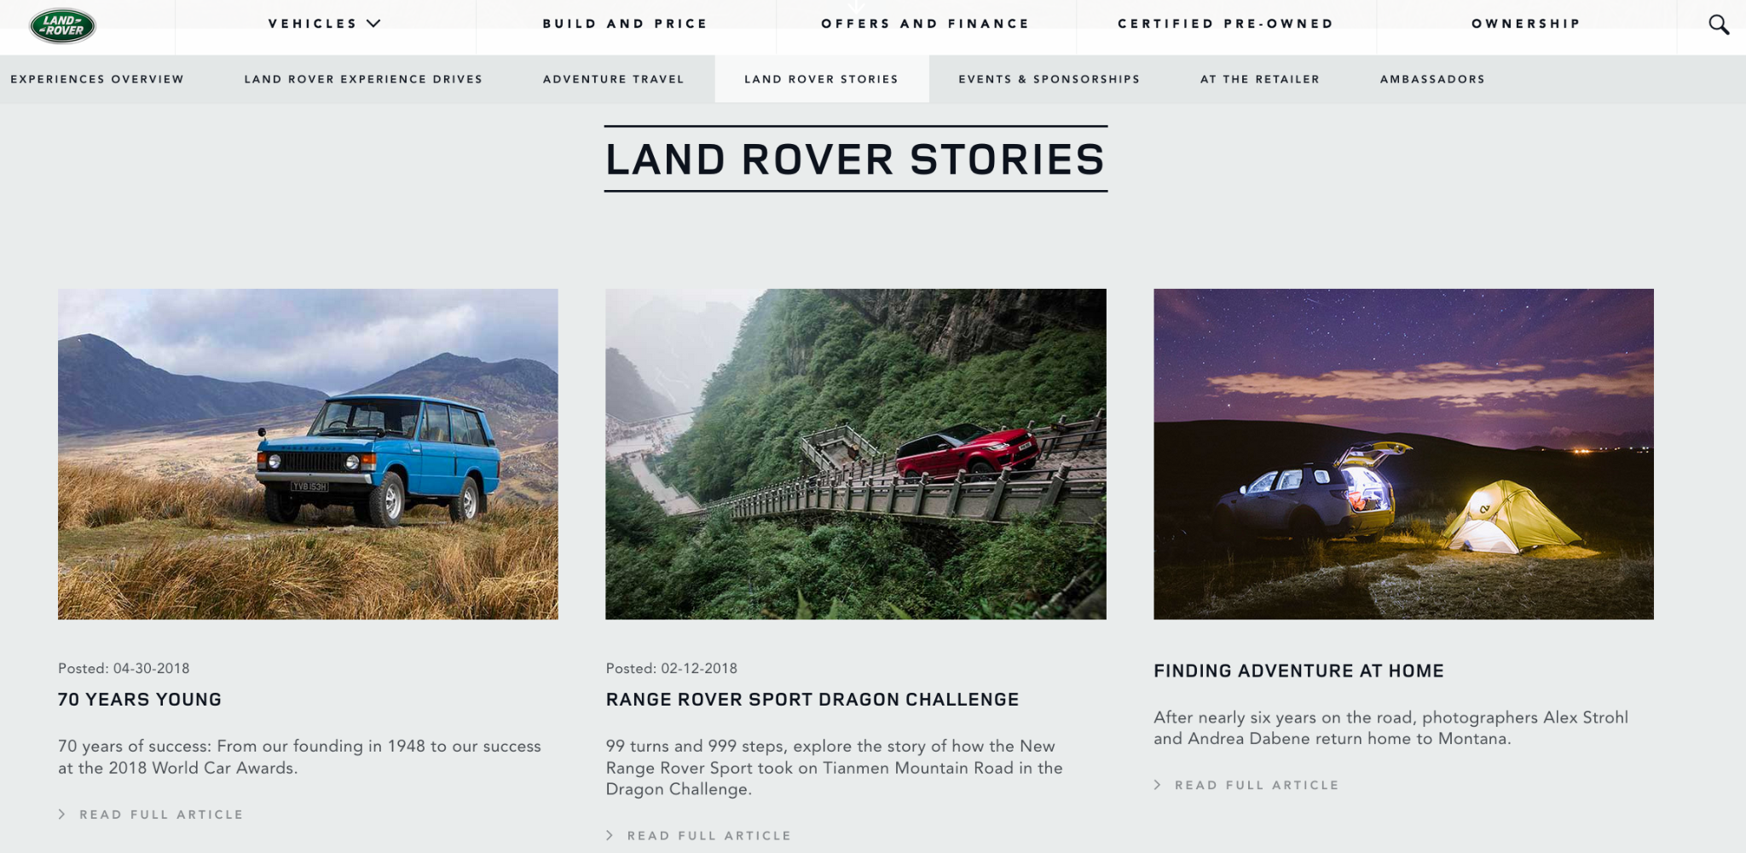
Notes:
It is a travel series that follows photographers' adventures during driving their Land Rovers at beautiful places like China and the mountains of Colorado and Alaska. On Instagram, where it promotes its stories, it has 8 million fans, with thousands of engagements on every post. That's why we decided to start with a few short films starring our vehicles and distribute them on social media.

Slide 26
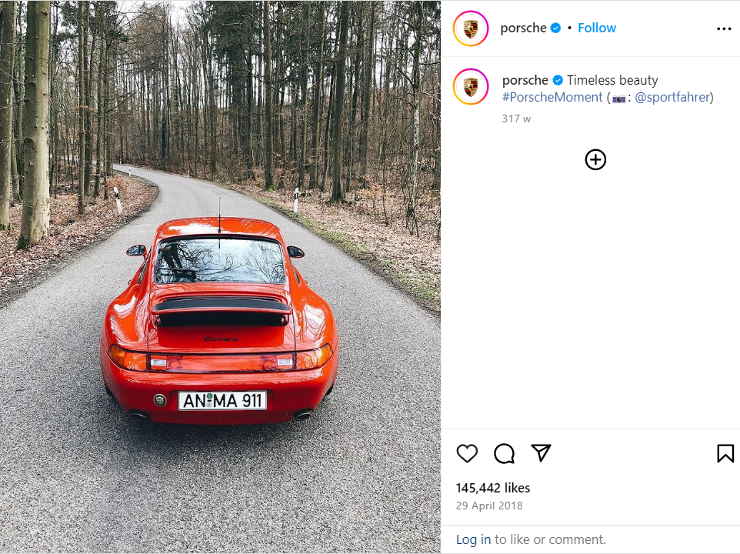
User Generated Content
Notes:
Porsche use the hashtag #PorscheMoment to encourage its fans to share posts. On Instagram more than 600,000 people have used the hashtag.

Slide 27
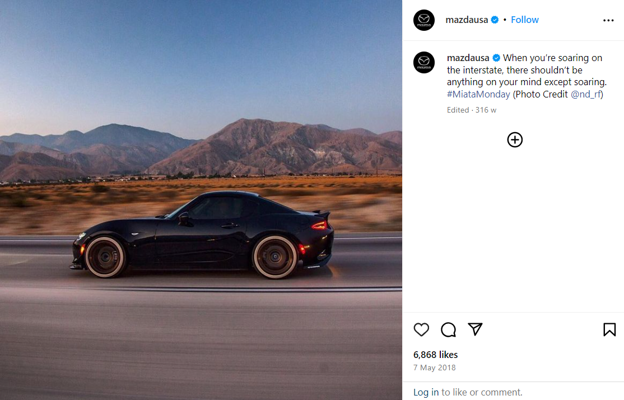
Notes:
Mazda is another company that uses a similar tactic by encouraging Miata users to post photos using the hashtag #MiataMonday

Slide 28
Email Marketing

Slide 29
75% of adults state that email is their preferred means of communication
For every dollar spent on email marketing, we can expect an average return of $38.
61% of consumers enjoy receiving weekly promotional emails
Notes:
We thought that email marketing should be an important part of our brand

Slide 30
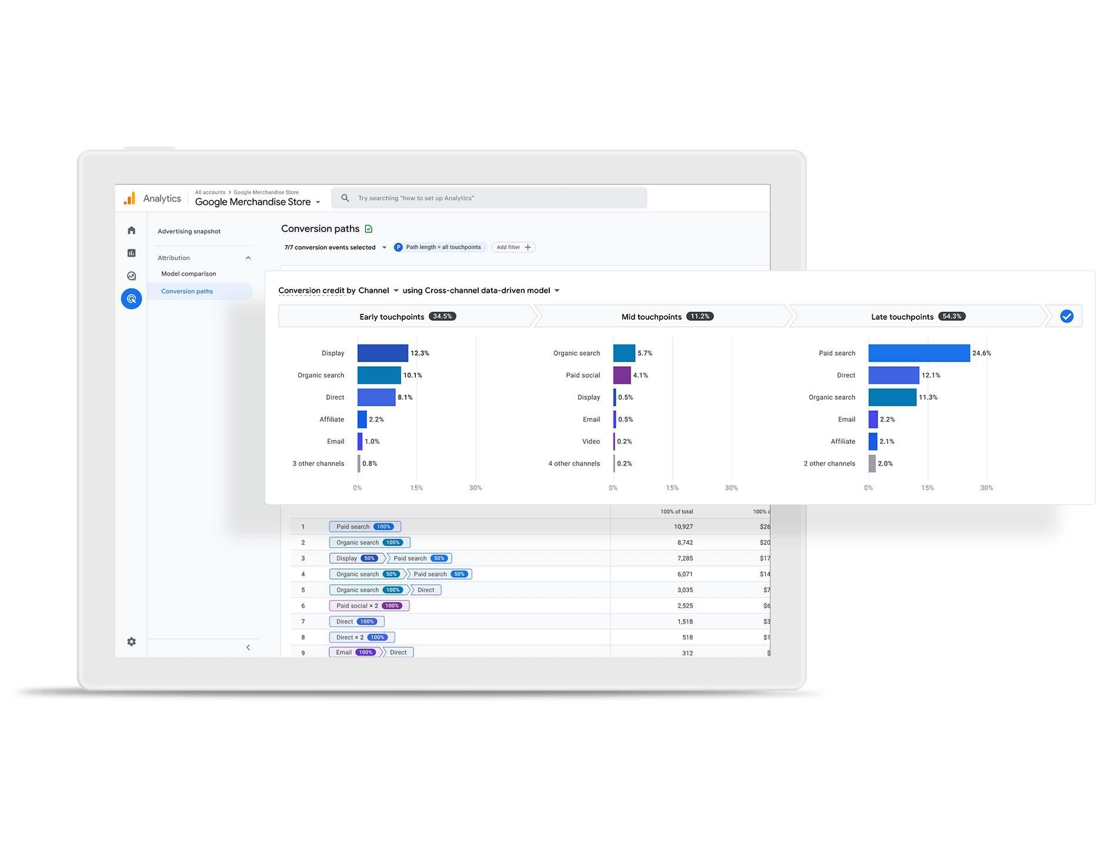
Google analytics
Notes:
We use analytics tools such as Google Analytics to understand demographic information so we can create particular types of email content based on these information

Slide 31
Optimize for Mobile
65% of all emails are currently opened via a mobile device
89% of marketers lose leads because their emails are poorly designed for mobile

Slide 32
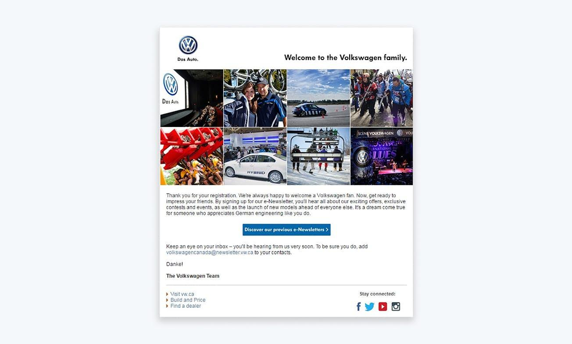
A subscriber welcome email from Volkswagen
Notes:
This email is a good example of personalization and strong email marketing communication.

Slide 33
Key Takeaways
Email marketing is one of the most powerful tools
Understanding audience and data to build email list are important for email marketing success.

Slide 34
